Slide 1
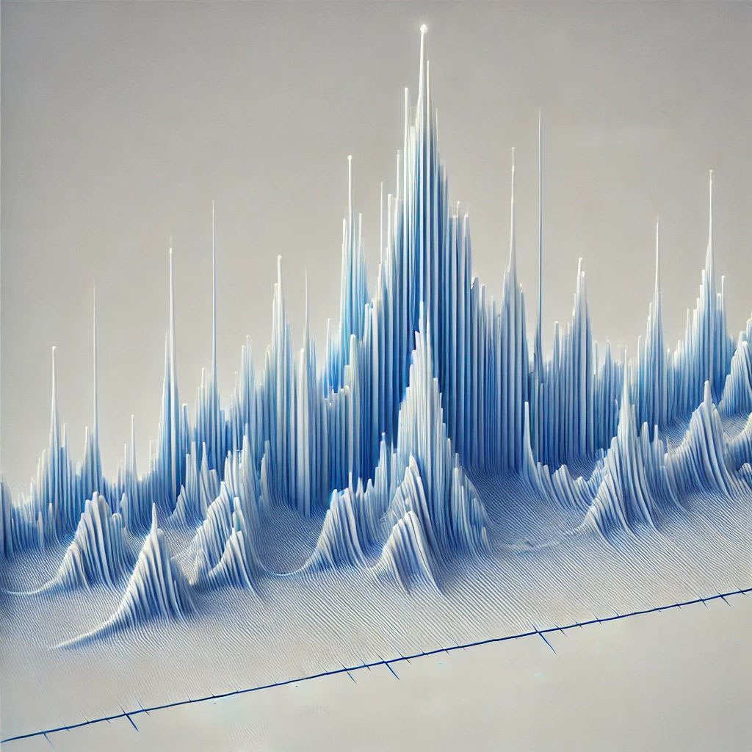
Rietveld Refinement of Powder Diffraction Data
ACerS Workshop: Tools for Visualizing and Understanding the Structure of Crystalline Ceramics
Taylor Sparks
Professor of Materials Science & Engineering, University of Utah

Slide 2


Download the software and tutorial materials now, the files are large
GSAS-II software
~400 MB download, 2 GB installed
Workshop tutorial materials
~30 MB

Slide 3
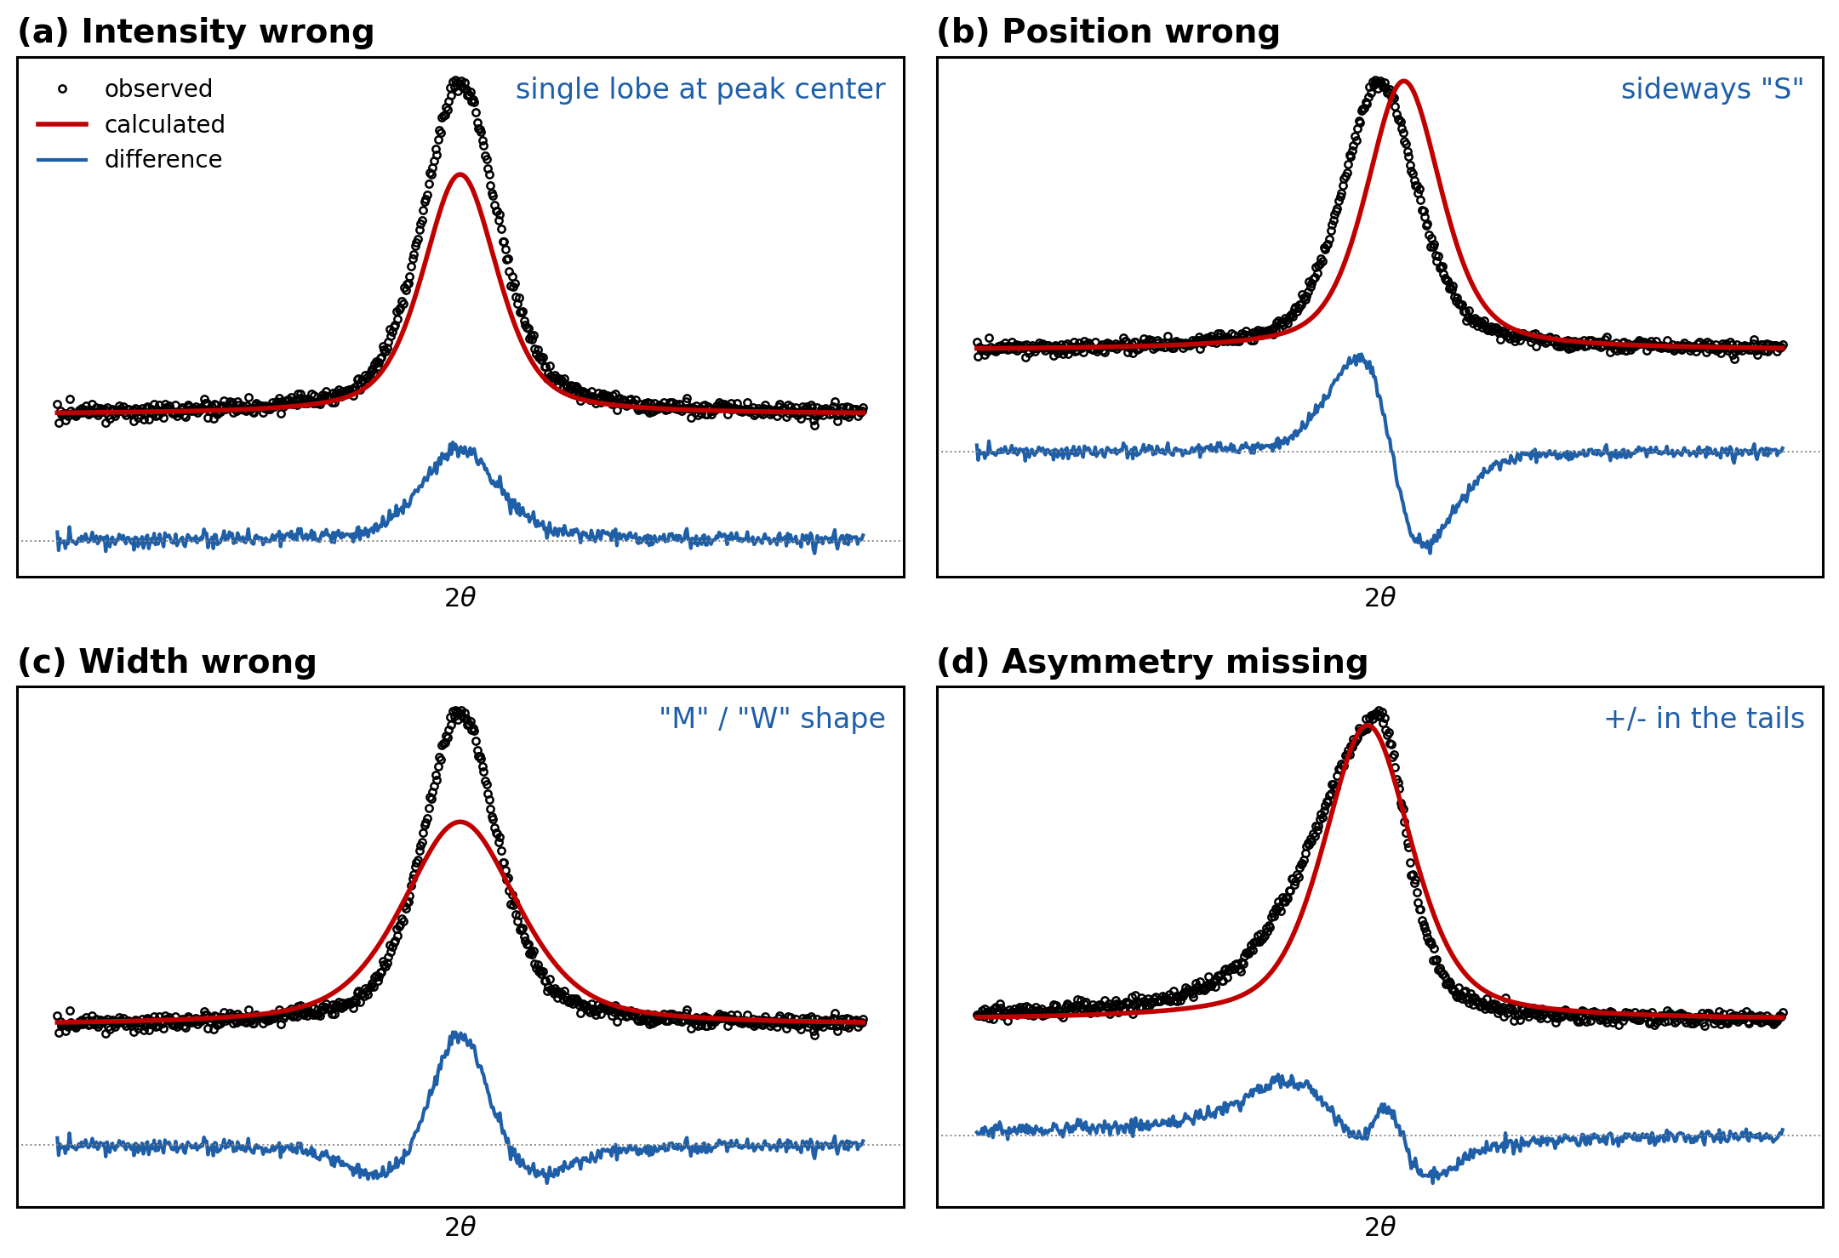
One technique answers many quantitative questions
What is Rietveld refinement and how does it work?
Quantitative analysis of multiphase mixtures
  Amorphous content
Atomic positions and site occupancy
Thermal displacement parameters
Preferred orientation
Crystallite size and strain

Slide 4

Rietveld refinement least-squares fits a calculated pattern to your data
Hugo Rietveld (1969)
Calculated pattern vs measured pattern
Variable model parameters, adjusted by least squares
Accounts for measurement errors (shift, zero offset)
Different from Le Bail or Pawley (profile) fitting: those fit intensities without a structure
Ab initio structure determination is a separate, harder problem
Notes:
Rietveld 1969. Emphasize: we fit the WHOLE pattern with a physical model. http://www.ccp14.ac.uk/poster-talks/rietveld-csiro-axaa-99/rietveld/index.htm

Slide 5


GSAS-II and PowDLL cover the whole workflow for free
Notes:
GSAS-II tutorials: https://advancedphotonsource.github.io/GSAS-II-tutorials/index.html PowDLL: http://users.uoi.gr/nkourkou/powdll/

Slide 6
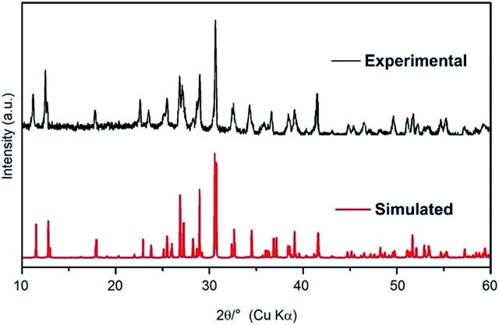
Modern software simulates powder patterns remarkably well

Slide 7
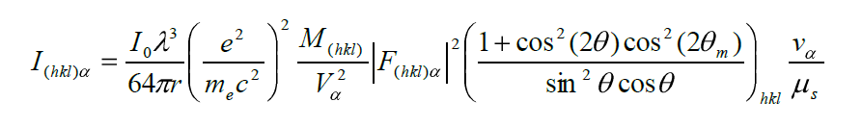
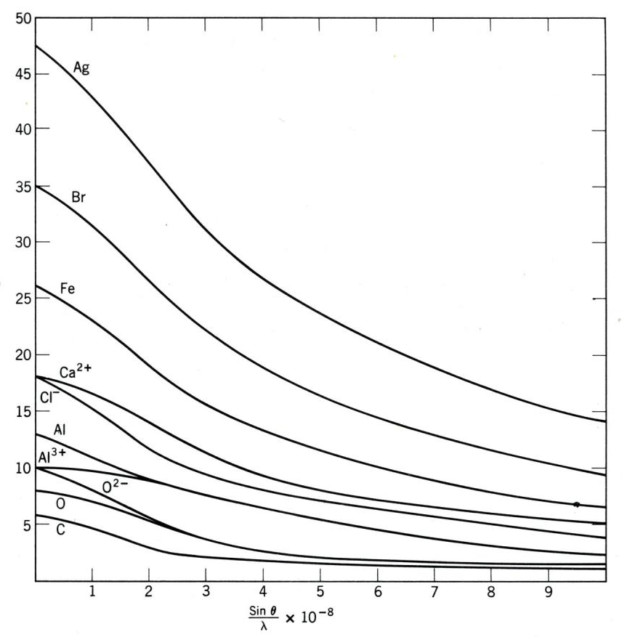


Peak intensity folds in source, sample, and structure factors
James R. Connolly, EPS400-001, Introduction to X-Ray Powder Diffraction, 2010
Notes:
I = incident intensity, geometry, absorption, phase volume fraction, multiplicity, Lorentz-polarization, unit-cell volume, and |F(hkl)|^2. Point at each factor: this is why intensities carry structural information.

Slide 8
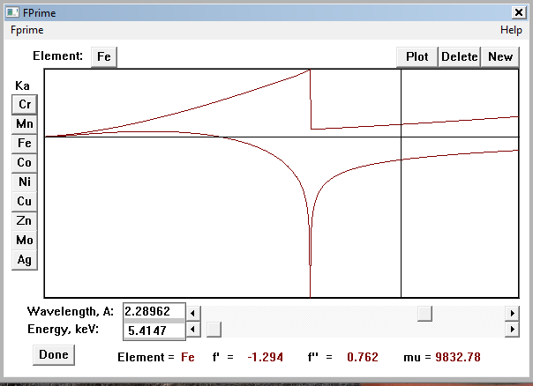
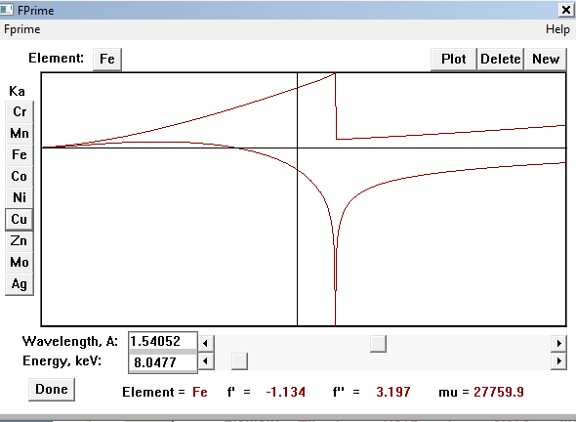
Radiation choice sets the anomalous scattering factors f' and f''
Notes:
https://www.xtl.ox.ac.uk/resources/software/fprime.html

Slide 9
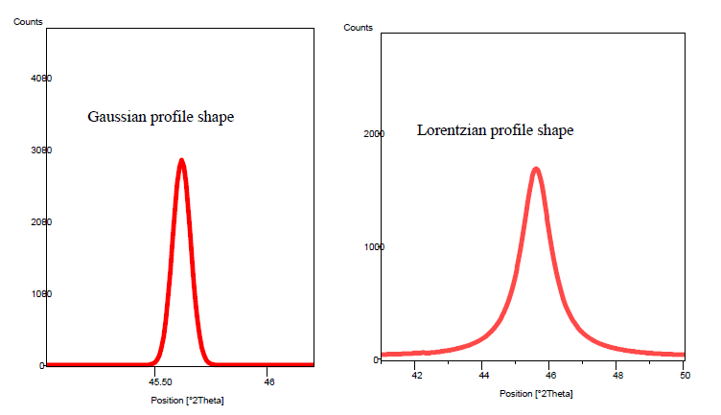

The instrument dictates Gaussian vs Lorentzian peak character
prism.mit.edu/xray/Rietveld_XRDSimulation.pdf

Slide 10
Every parameter changes the pattern in one of three ways
WHERE peaks sit
Lattice parameters (a, b, c, angles)
Zero offset
Sample displacement
WHAT SHAPE they have
Gaussian widths: U, V, W
Lorentzian widths: X, Y
Asymmetry (axial divergence)
Size and strain broadening
HOW TALL they are
Scale factor(s)
Atomic positions (x, y, z)
Site occupancies
Thermal parameters (Uiso, Uij)
Preferred orientation
Absorption, roughness
Diagnosis strategy: when the fit is bad, ask which bucket is wrong. Each bucket leaves a different fingerprint in the difference curve.
Notes:
Frame for everything that follows: every checkbox in GSAS-II lands in one bucket. Positions, shapes, or intensities. When a fit is bad, diagnose by bucket before touching anything.

Slide 11
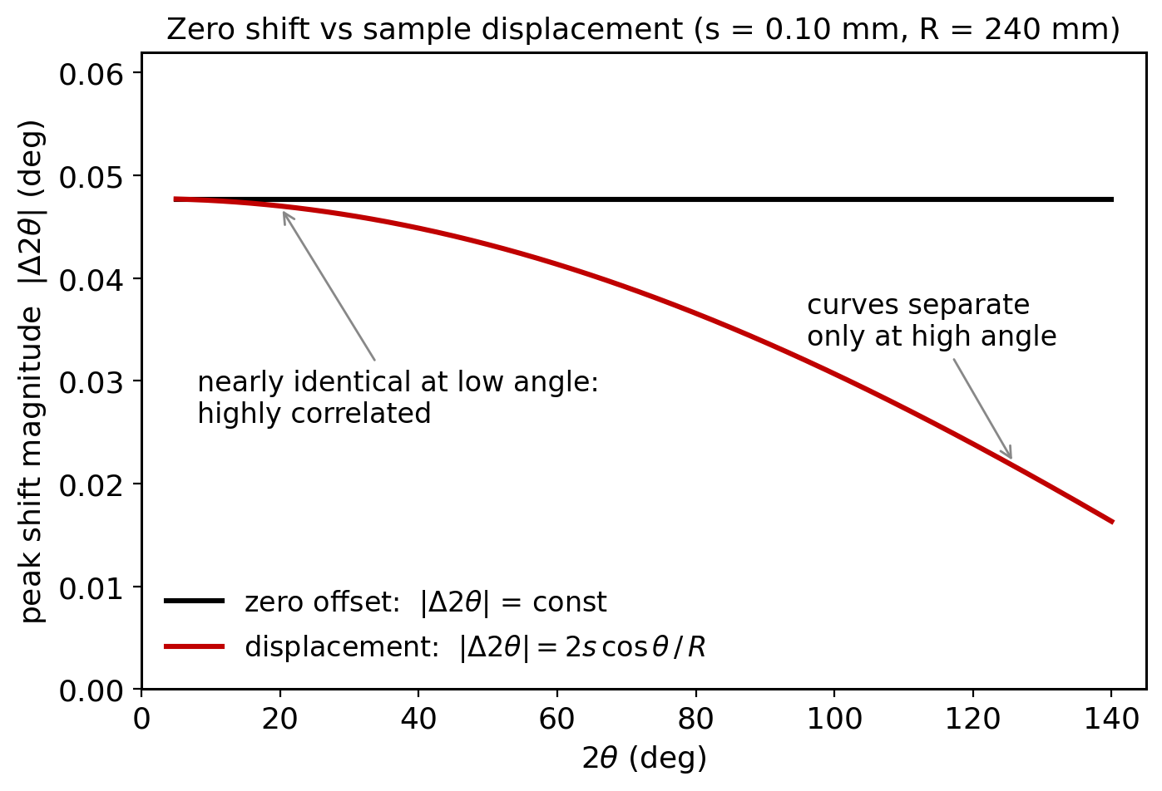
Peak positions must match before anything else can refine
Two rival corrections:
  Zero offset: Δ2θ = const.
  Displacement: Δ2θ = −2s cosθ/R
Nearly identical at low angle, so the two are highly correlated
Fix: internal standard (NIST Si 640) pins one of them
If positions are off, nothing downstream can converge (McCusker et al., 1999)
Notes:
Zero shift is constant; displacement dies off as cos(theta). Nearly identical below ~40 deg, so refining both from limited data is asking for trouble. Internal Si standard breaks the tie. McCusker: if positions are off, nothing else can converge.

Slide 12
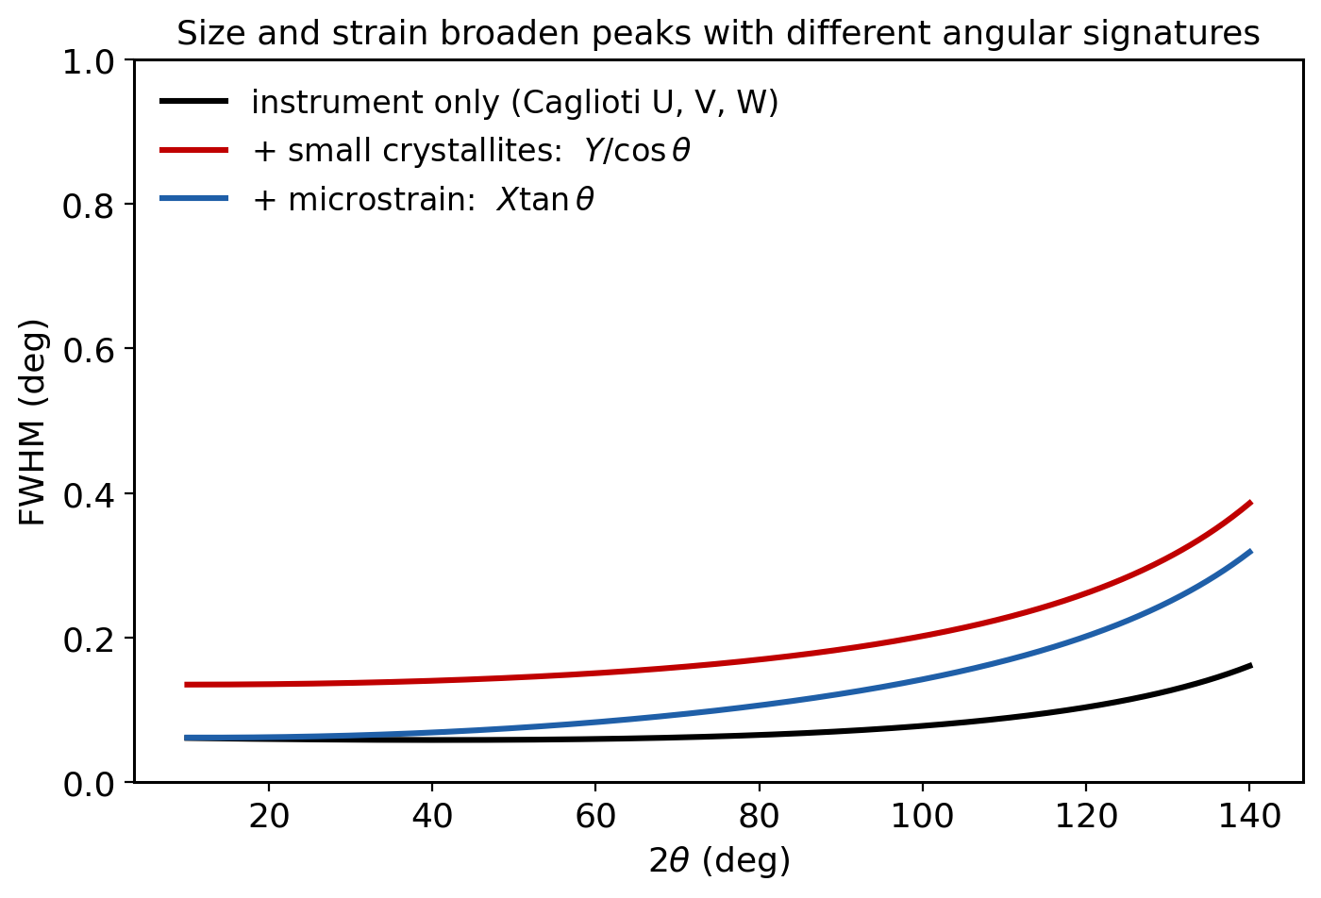
Peak widths encode real microstructure through U, V, W, X, Y
Gaussian part (Caglioti, 1958):
  FWHM² = U tan²θ + V tanθ + W
Lorentzian part:
  FWHM = X tanθ + Y / cosθ
X grows like strain broadening (tanθ)
Y grows like size broadening (1/cosθ, Scherrer)
Profile terms are physics, not fudge factors
Notes:
U, V, W set the Gaussian width; X and Y the Lorentzian. Key point: X goes as tan(theta) like strain, Y as 1/cos(theta) like Scherrer size. Characterize the instrument with a standard first; sample broadening is what is left over.

Slide 13
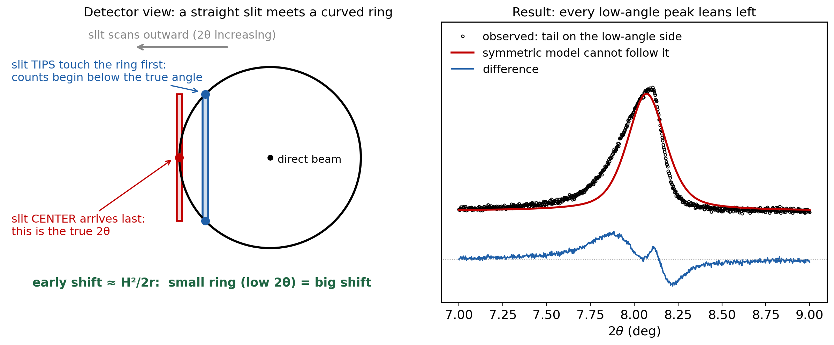
Axial divergence makes low-angle peaks lean; correct it, don't absorb it
Diffraction makes cones; on the detector they are rings, and low-angle rings are small and strongly curved
The receiving slit is straight and tall: scanning outward, its tips clip the ring before its center gets there, so counts arrive early and pile up on the low-angle side
The early shift scales as H²/2r, which is why the lean is worst at low 2θ (and on high-resolution instruments)
Model it with the Finger-Cox-Jephcoat correction (built into GSAS-II); never absorb it into peak width
Notes:
The Debye ring is curved, the slit is straight. At low angle the curvature within the slit smears counts to low 2-theta, so peaks lean left. Use the FCJ correction; if you fake it with extra width, sizes and strains come out wrong.

Slide 14
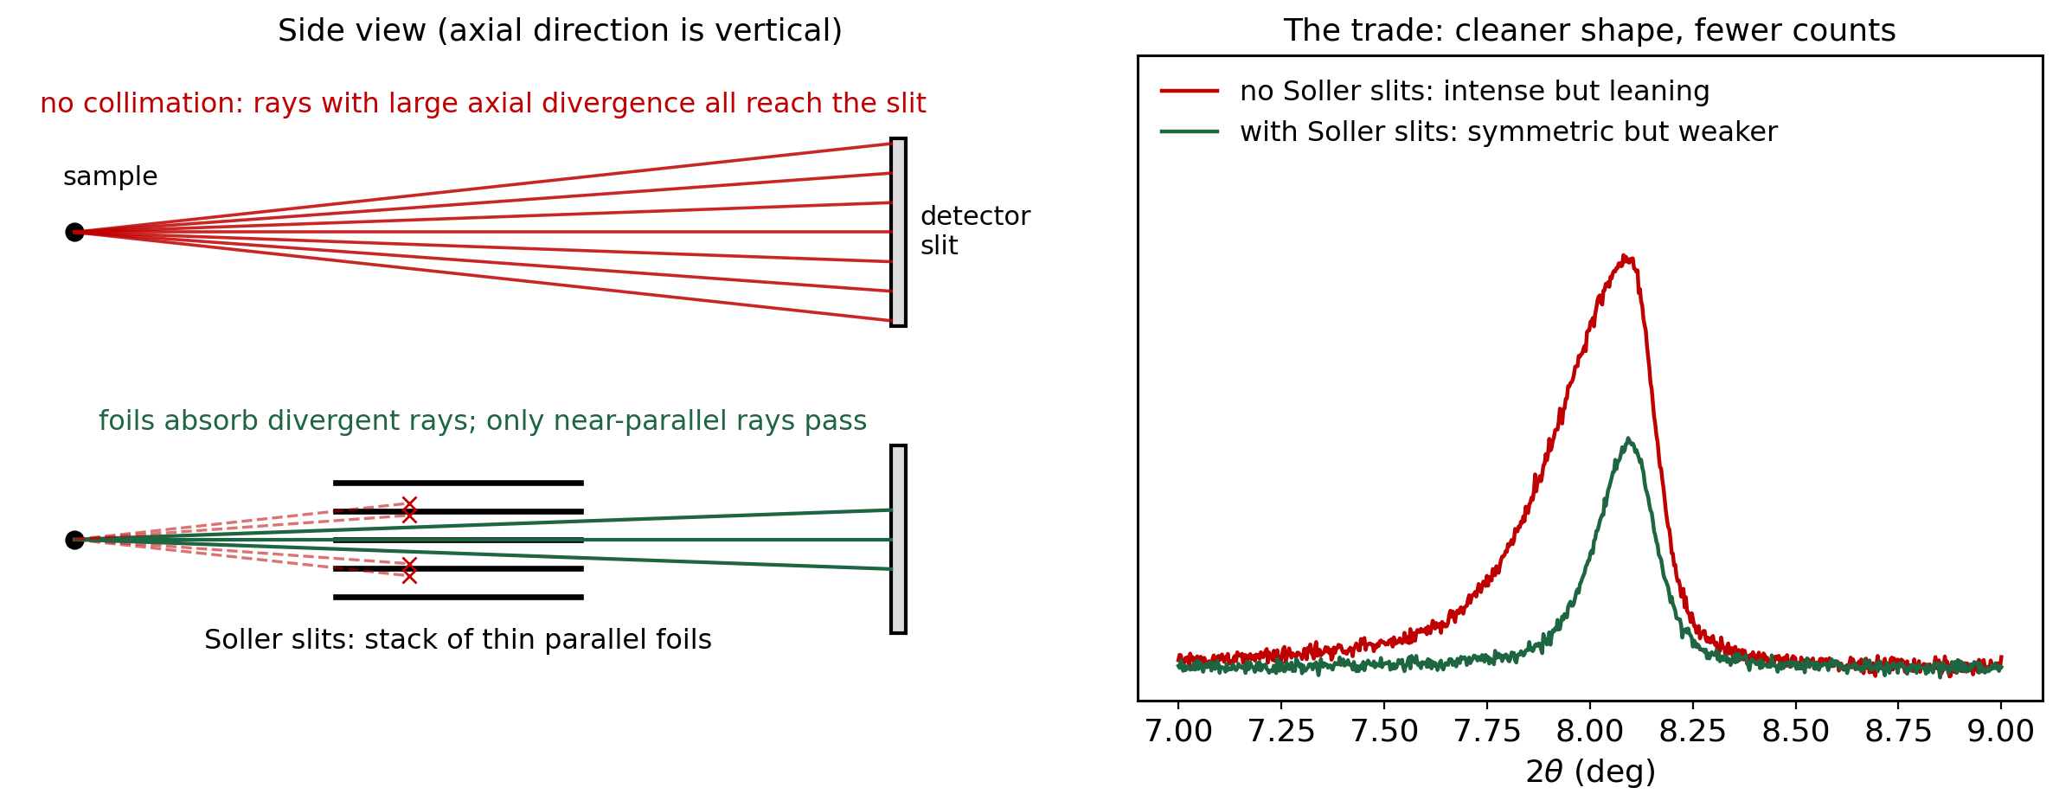
Soller slits tame axial divergence, at the cost of intensity
A stack of thin parallel foils limits out-of-plane divergence to roughly (foil spacing) / (foil length)
Less axial divergence = shorter low-angle tail and more accurate peak positions
The price is counts: every blocked ray is simply lost, so counting times grow
Some asymmetry always survives, so the Finger-Cox-Jephcoat correction still applies
Notes:
Hardware fix vs software fix. Soller slits shrink H in the H^2/2r shift, trading intensity for shape. Good instruments do both: collimate what you can, model what remains with FCJ.

Slide 15
The difference curve tells you which parameter is wrong
Real misfits are superpositions of these four fingerprints (after McCusker et al., J. Appl. Cryst. 32, 36, 1999)
Notes:
The money slide. Intensity error: single lobe. Position error: sideways S. Width error: M or W. Missing asymmetry: wiggle in the tails. Real refinements superpose these. Have audience call out the fingerprint for each panel.

Slide 16
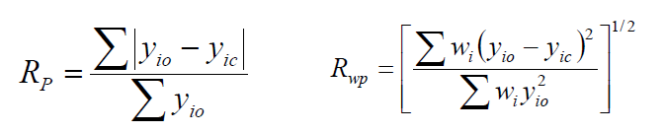
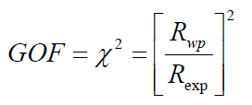
Rp, Rwp, and chi-squared put numbers on the fit
Rp: plain difference between observed and calculated intensities
Rwp: weighted, so strong peaks matter more than weak ones; this is what least squares minimizes
Common guideline: Rwp < 10% or χ² < 4 for a good fit
prism.mit.edu/xray/RietveldGOF.pdf

Slide 17
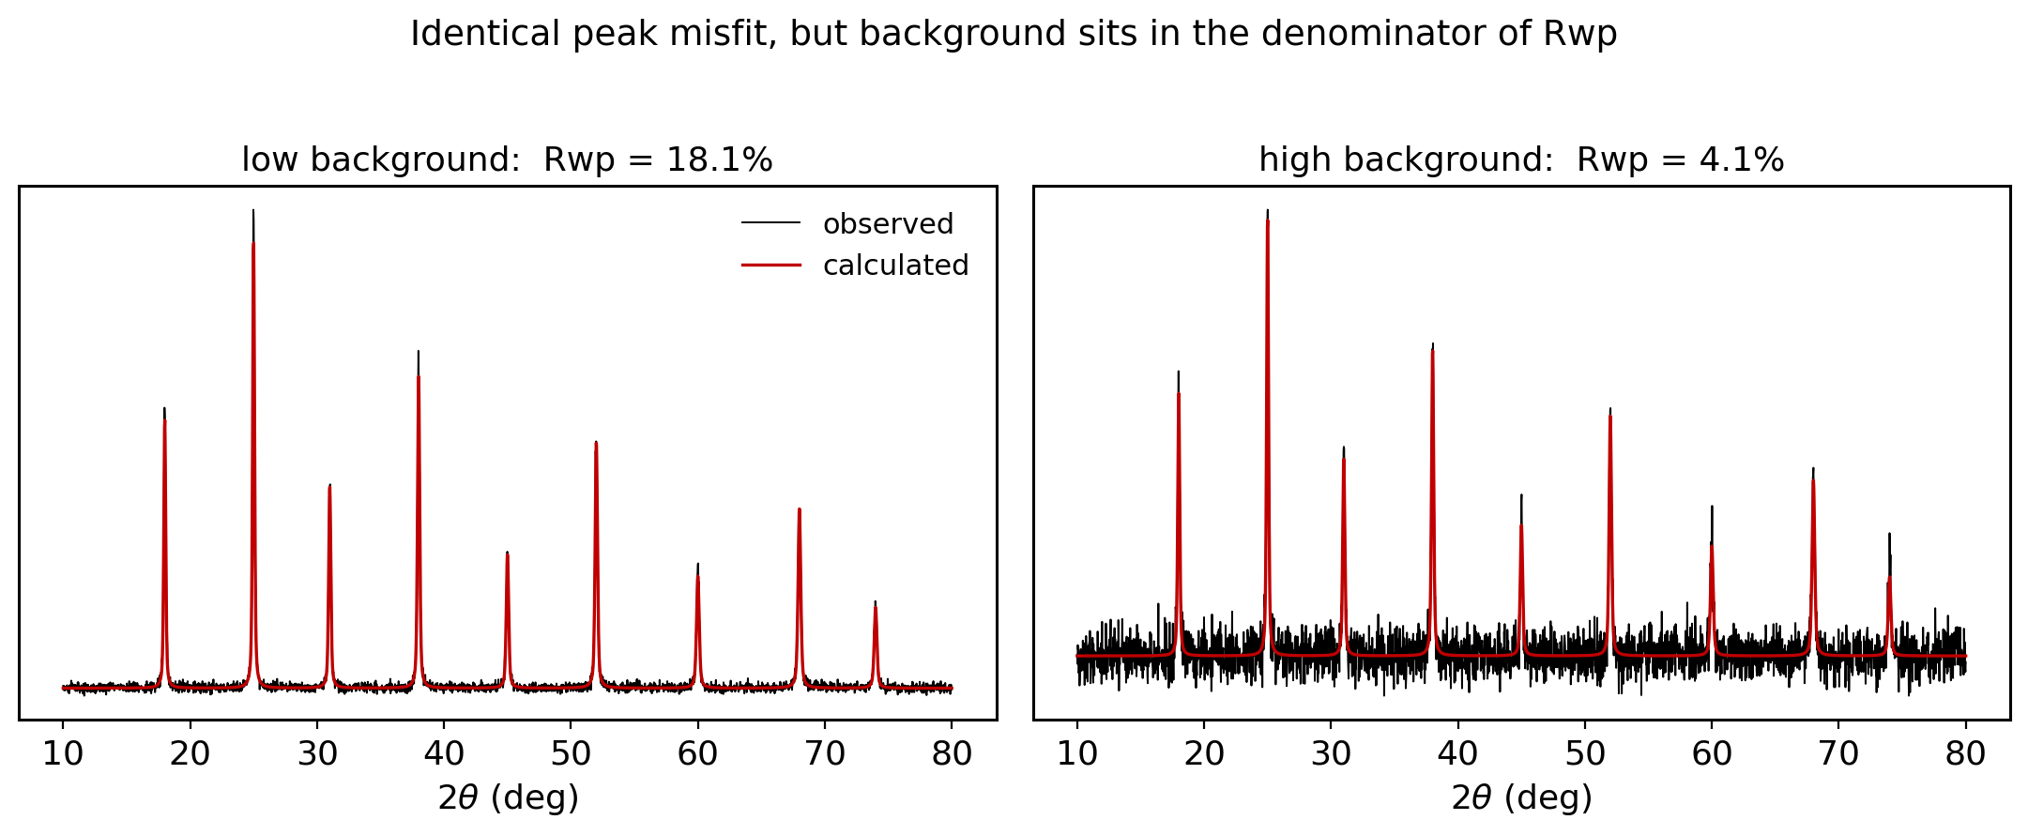
A good Rwp can hide a bad fit, and vice versa
Background sits in the denominator: high background flatters Rwp for the very same peak misfit
Never compare Rwp across instruments: TOF neutron at 3% and lab XRD at 10% can be equally good fits
Your floor is the Le Bail Rwp; judge fits with the plot and chemical sense, not the number (Toby, 2006)
Notes:
Both panels have the identical peak misfit; only the background changed, and Rwp fell from 18 to 4 percent. Moral: Rwp is not comparable across experiments. The Le Bail fit is your floor. Judge with the plot and chemistry (Toby 2006).

Slide 18
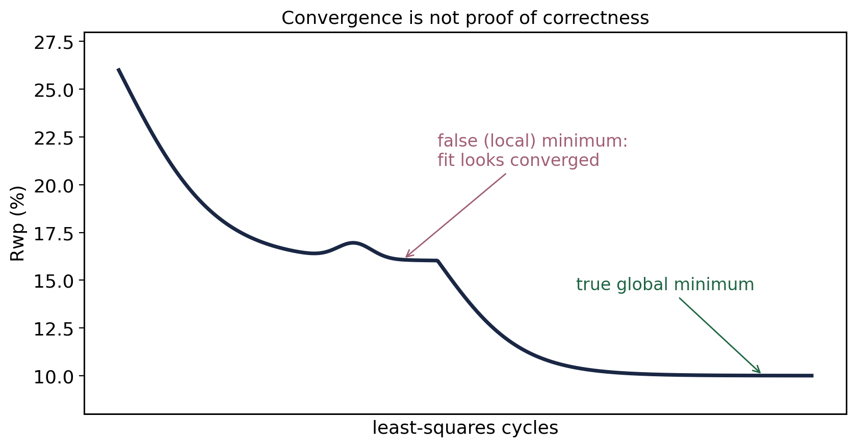
Convergence to a minimum is not proof you found THE minimum
"A Rietveld refinement is never finished, only abandoned." P. W. Stephens
Notes:
Run cycles in small batches, watch shift/esd, and be willing to back out. A flat Rwp can be a shelf, not the floor.

Slide 19
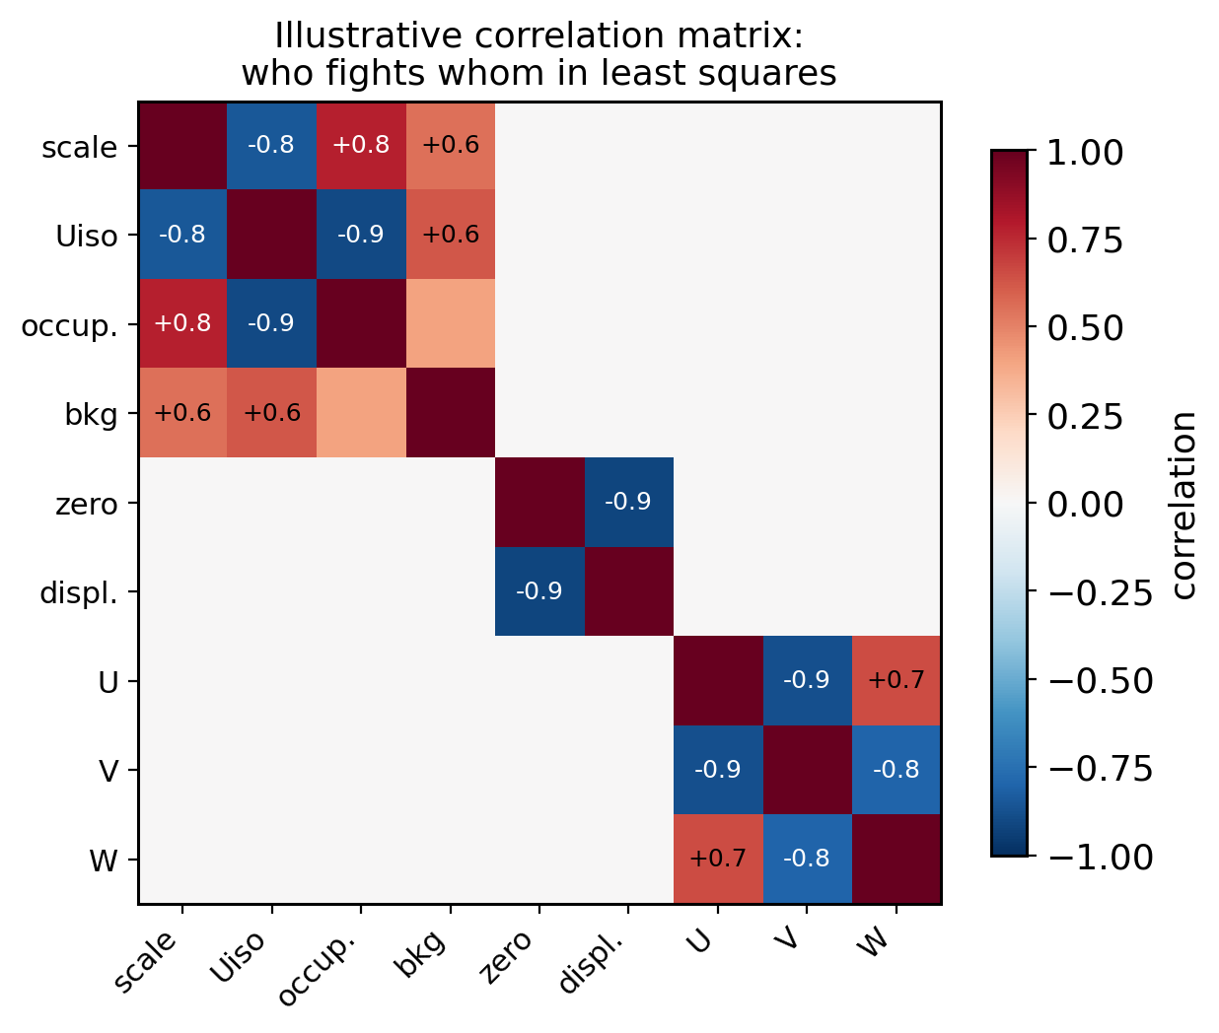
Refinement turn-on order is correlation management
1. Scale + background
2. Lattice + zero (or displacement)
3. Profile: W first, then U, V, X, Y
4. Positions: heavy atoms, then light
5. Uiso (constrain similar atoms early)
6. Occupancies last, then all together
Rule of thumb: observations per parameter ≥ 3, ideally 5
Notes:
The recipe is correlation management: free the parameters that move the residual most and fight least, first. Heat map shows the usual suspects: scale vs Uiso vs occupancy, zero vs displacement, U vs V vs W. End with the 3-to-5 observations-per-parameter rule.

Slide 20
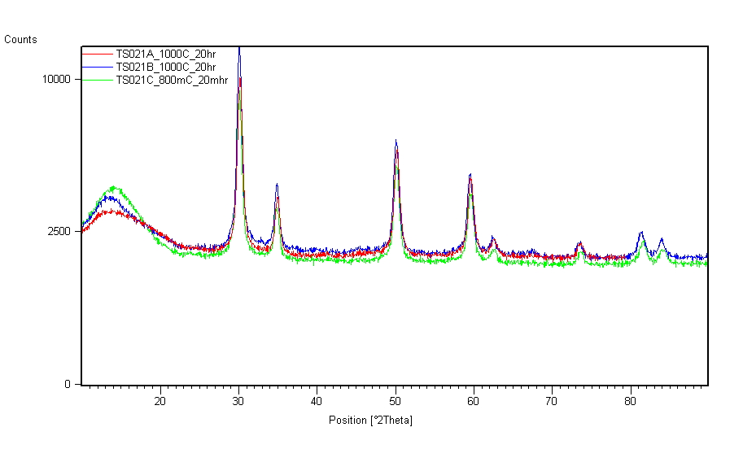
Multiphase analysis starts by matching the peak list to phases

Slide 21
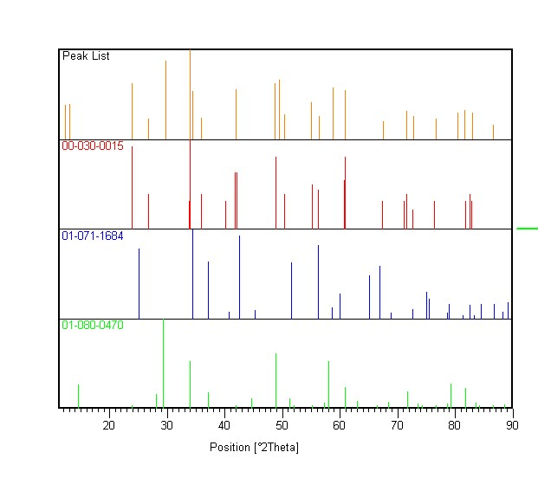
A three-phase Rietveld fit resolves the mixture directly

Slide 22
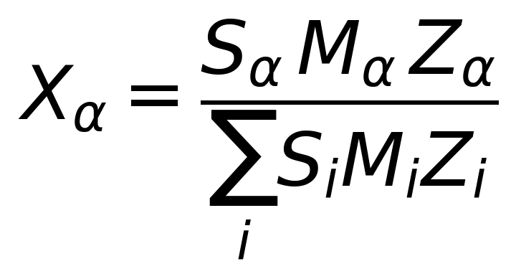
The SMZ relation converts scale factors into weight fractions
S is the phase scale factor, proportional to the number of unit cells measured
M is the molecular weight
Z is the number of formula units per unit cell
The product SMZ is proportional to the concentration of each phase

Slide 23
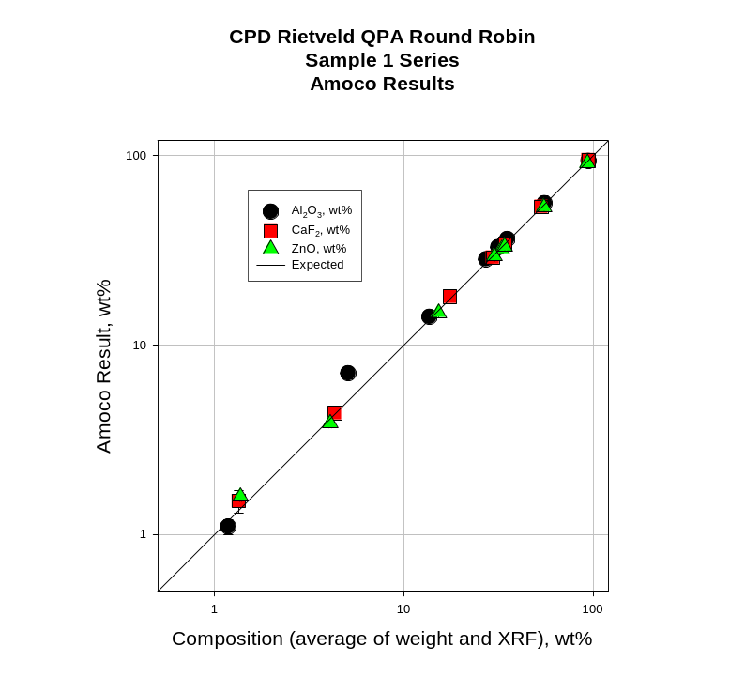
Round-robin studies show quantitative analysis is accurate to a few percent
James Kaduk, ICDD, Rietveld Refinement Workshop, Oct 2010
Notes:
CPD Rietveld QPA round robin, Amoco results. https://journals.iucr.org/j/issues/2001/04/00/hw0085/hw0085.pdf

Slide 24
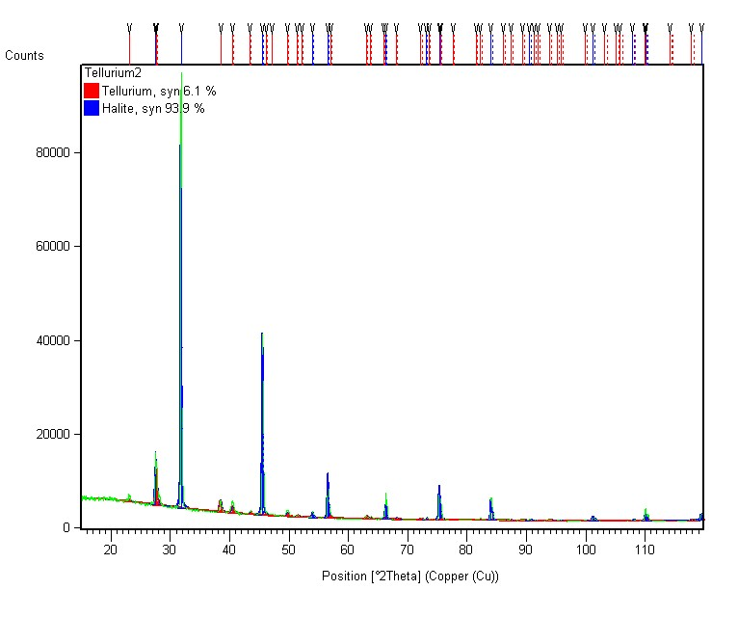
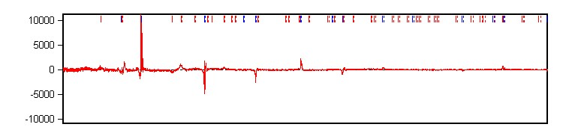
Rietveld quantifies 6% tellurium recovered from a seawater medium
93.9% NaCl
6.1% Te
Rwp = 6.9%
Error sources: absorption (transparency), sample volume (more powder)

Slide 25
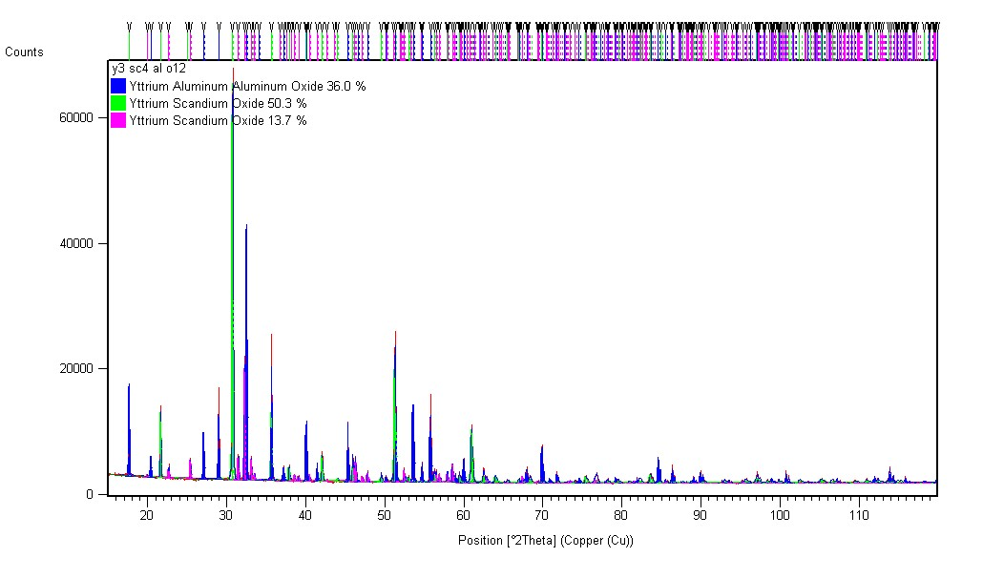
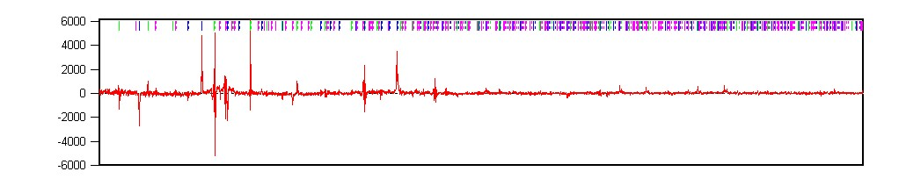
The intended Y3Sc4AlO12 actually crystallized as three phases
36% YAG (Ia-3d)
50.3% YScO3 (Ia-3)
13.7% YScO3 (Pnma)
Rwp = 5.3%

Slide 26
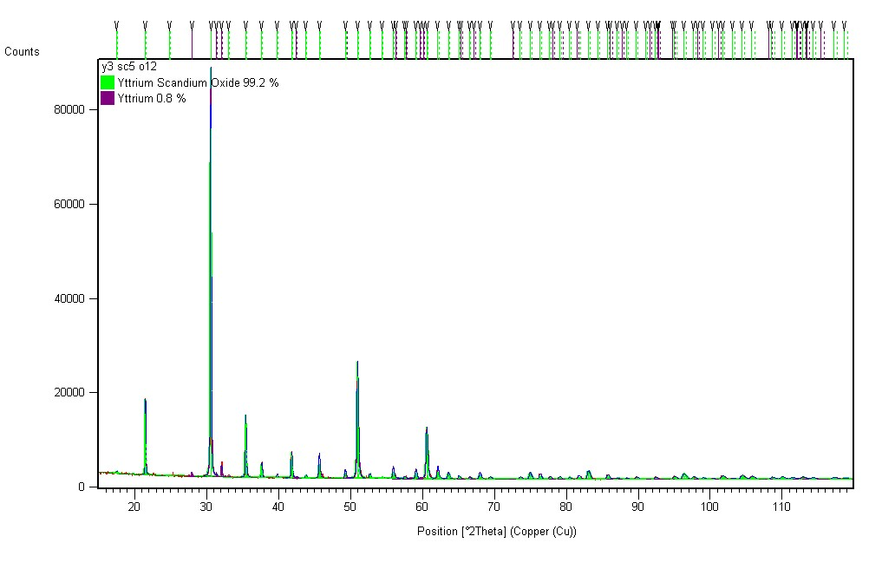
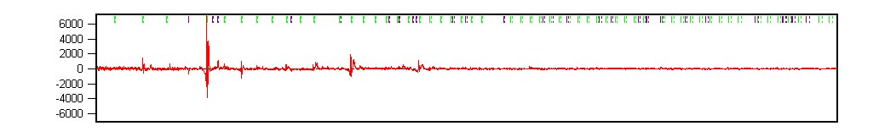
Y3Sc5O12 instead formed nearly phase-pure bixbyite
99.2% Y3/4Sc5/4O3 (Ia-3)
0.8% Y (P63/mmc)
Rwp = 4.7%

Slide 27
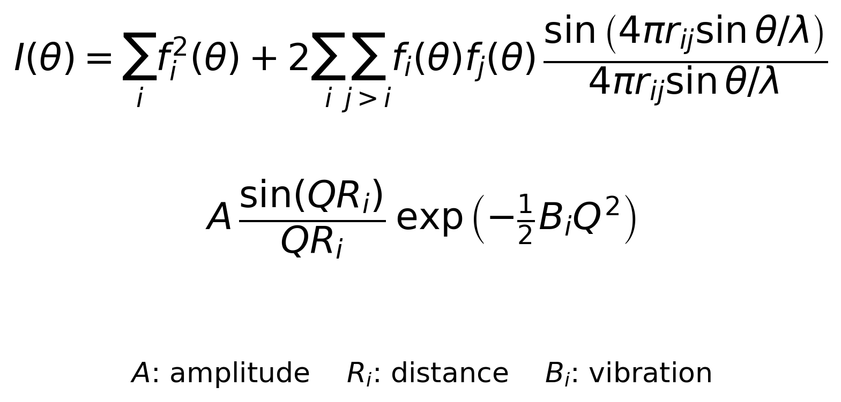
The Debye equation extends analysis to amorphous content
Percent amorphous material can be determined if a standard is added in a known amount
Terms describe interatomic distance and vibration amplitude
A radial distribution function is needed to determine bond distances for analysis

Slide 28
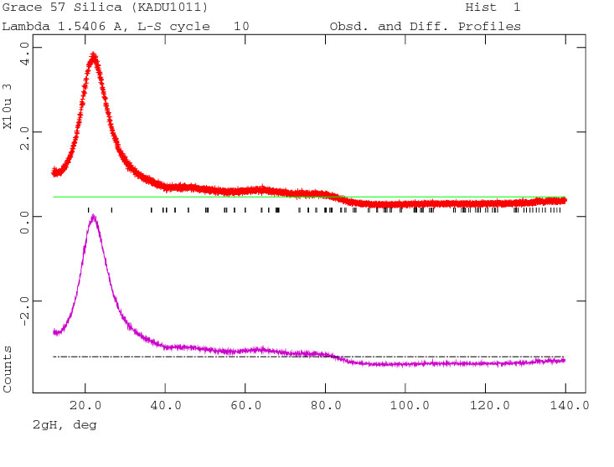
Glassy silica's diffuse scattering can be fit, not just subtracted
James Kaduk, ICDD, Rietveld Refinement Workshop, Oct 2010

Slide 29
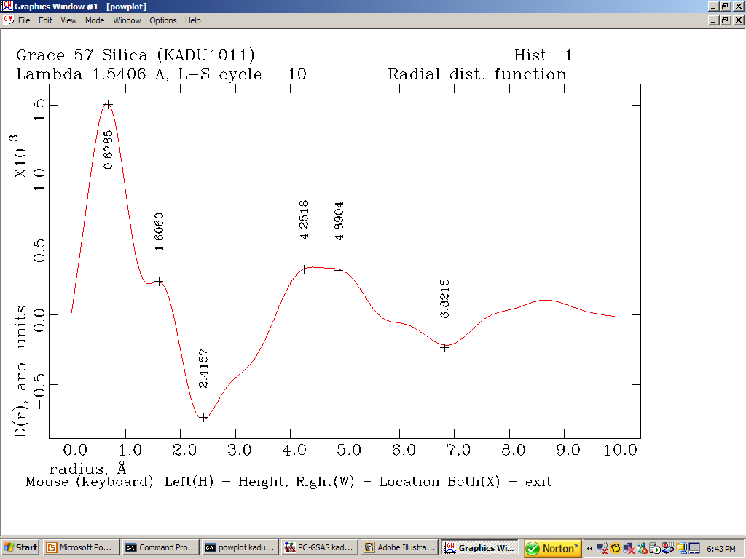
The refined model yields a real-space radial distribution function
James Kaduk, ICDD, Rietveld Refinement Workshop, Oct 2010

Slide 30
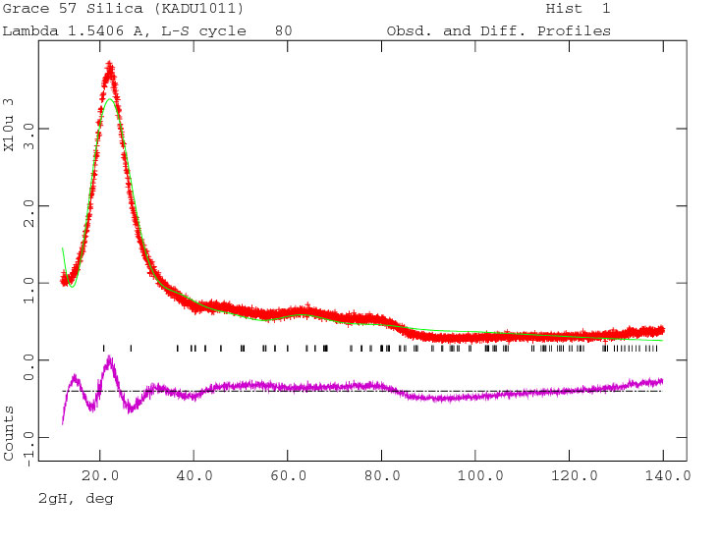
Iterating the Debye model steadily improves the diffuse fit
James Kaduk, ICDD, Rietveld Refinement Workshop, Oct 2010

Slide 31
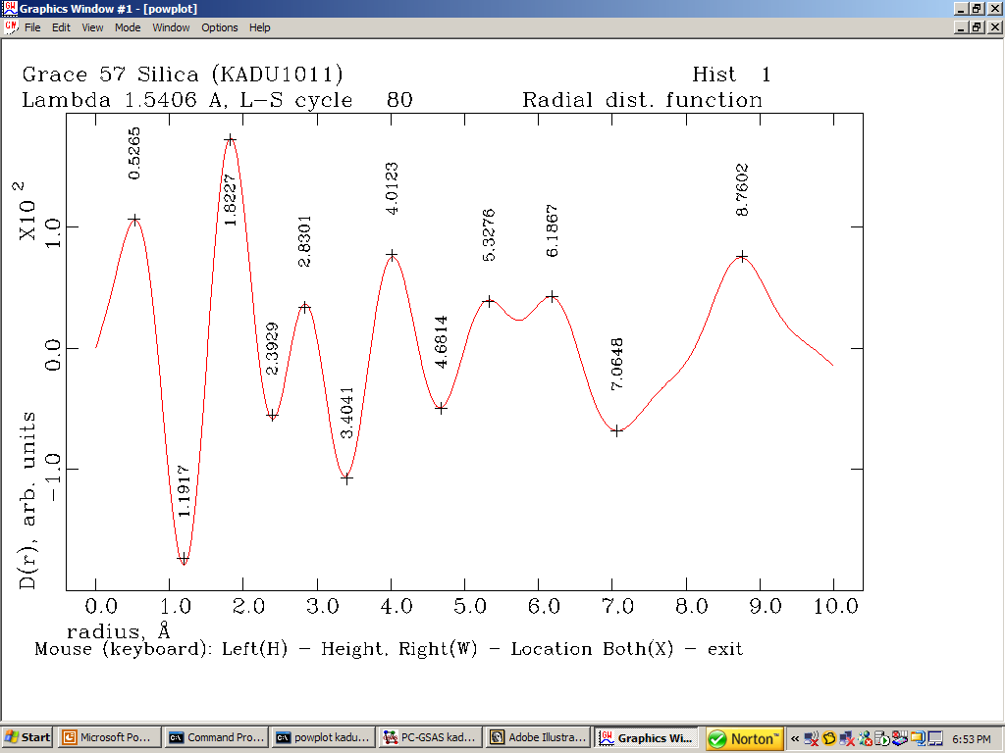
RDF peaks index directly to coordination shells
James Kaduk, ICDD, Rietveld Refinement Workshop, Oct 2010

Slide 32
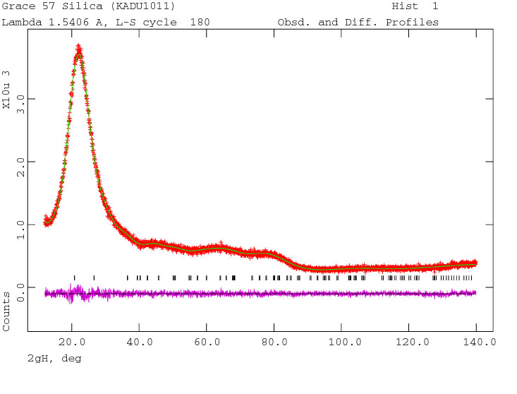
The final diffuse fit converges with chi-squared = 1.11
James Kaduk, ICDD, Rietveld Refinement Workshop, Oct 2010

Slide 33
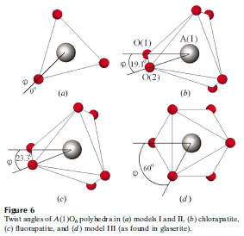
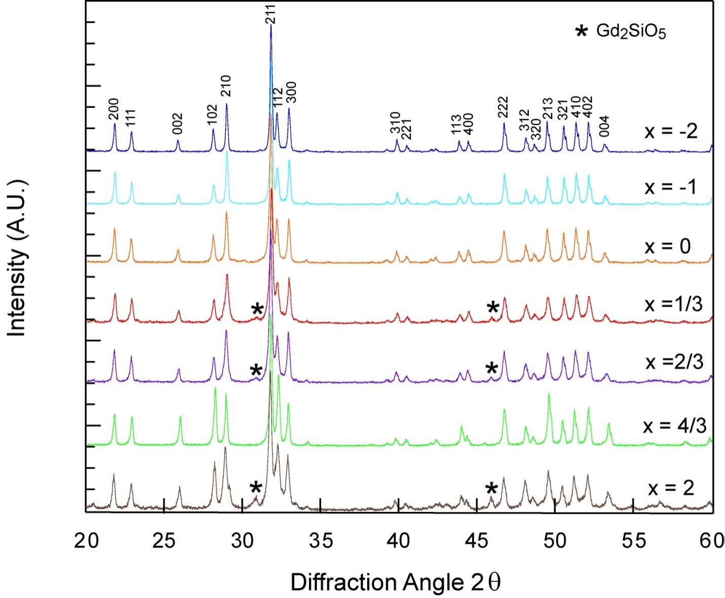
Lab XRD alone cannot settle apatite site occupancies
Gd8+xCa2+y(SiO4)6O2+3x/2+y system with anion/cation vacancies
Lab XRD is insufficient to answer:
  Impurity wt%?
  Volume change?
  Cation site preference?
  Meta-prism twist?
Notes:
White et al., Structural derivation and crystal chemistry of apatites, Acta Cryst. B59, 1-16 (2003)

Slide 34
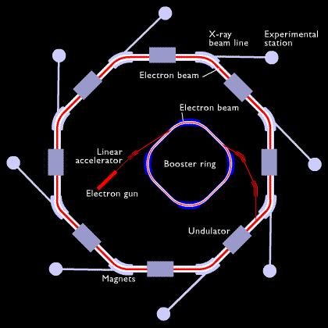
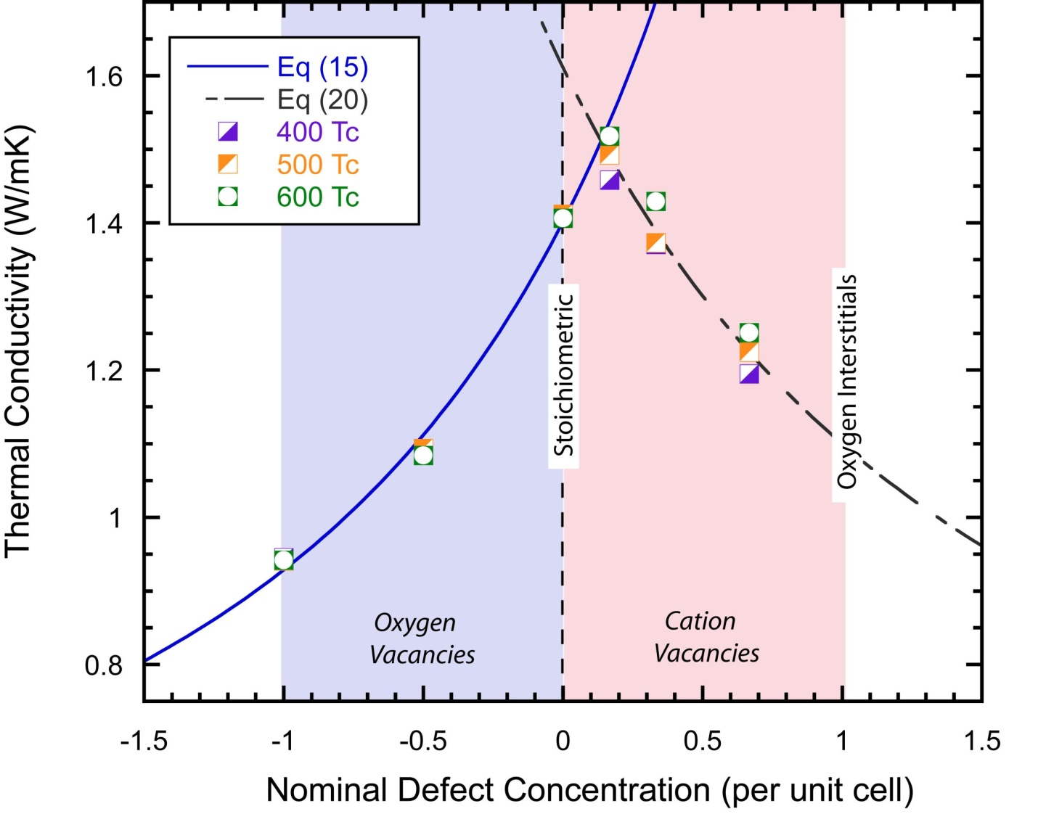
Synchrotron data adds the resolution occupancy refinement needs
Stoichiometric composition should have the highest thermal conductivity
  Phase separation?
Synchrotron diffraction brings:
  Improved signal-to-noise ratio
  Improved resolution
  Minimized anomalous scattering

Slide 35
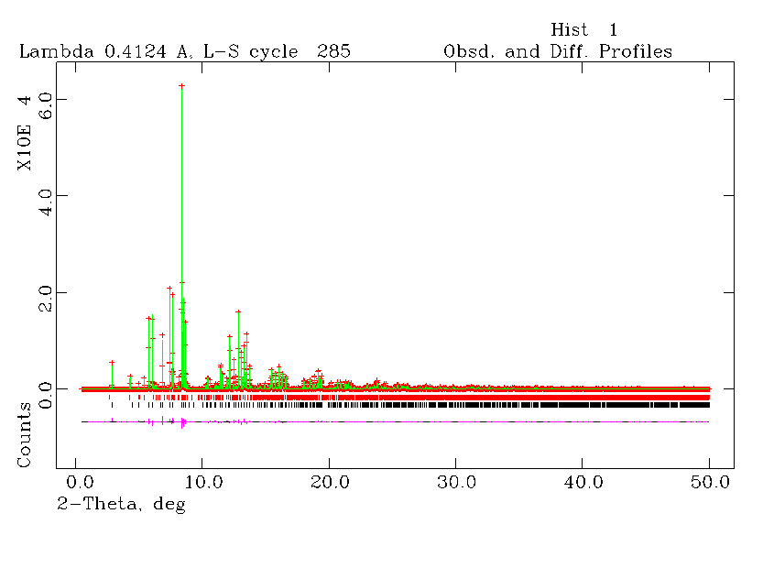
Refinement finds 5% Ca on A1 and a 23.6 degree meta-prism twist
Rwp = 6.29%
85% Gd7.7Ca2.3(SiO4)6O2
14% Gd2SiO5
Ca has ~5% on A1
Meta-prism twist 23.6°
Initial composition Gd8.333Ca1.5(SiO4)6O2

Slide 36
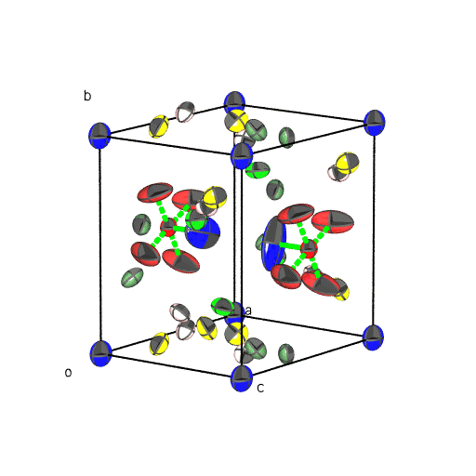
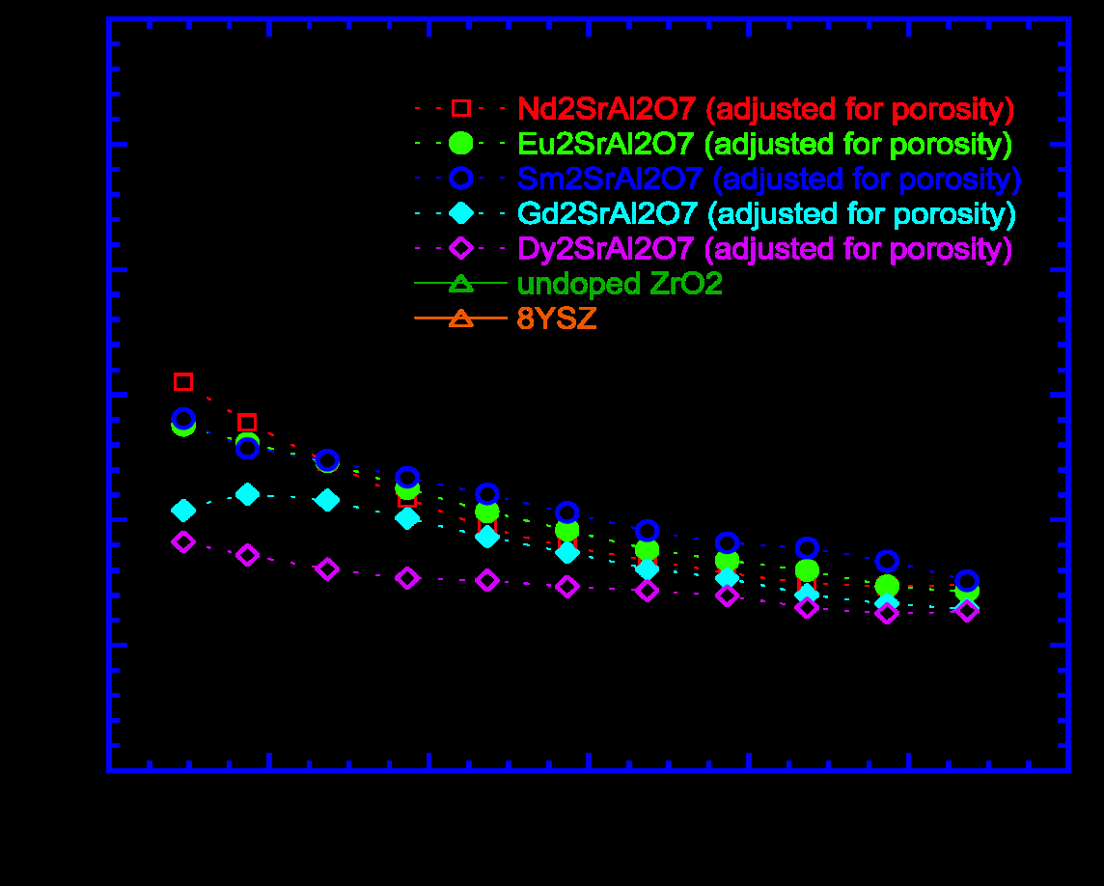
Large refined Uiso values can flag rattling atoms
Thermal vibrations are quantitatively studied in Rietveld refinement
  Uiso, or Uij for anisotropic vibration
Large U values could be due to rattling
  An explanation of RE2SrAl2O7 thermal conductivity?

Slide 37
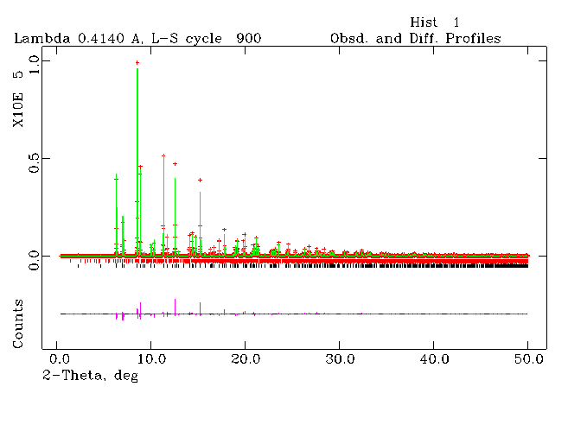
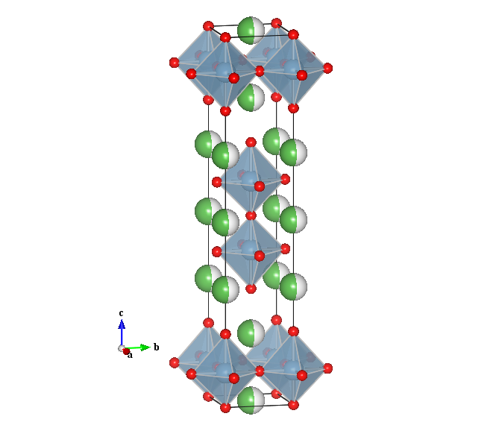
Occupancy and Uiso trends track across the RE2SrAl2O7 series
Composition | La2SrAl2O7 | Nd2SrAl2O7 | Sm2SrAl2O7 | Eu2SrAl2O7 | Gd2SrAl2O7 | Dy2SrAl2O7
Uiso A1 | 0.11(2) | 0.21(5) | 0.40(3) | 0.20(1) | 0.37(3) | 0.96(2)
A1 (P2) occupancy | .73 | .54 | .43 | .32 | .25 | .21
A2 (RS) occupancy | .27 | .46 | .56 | .67 | .72 | .79

Slide 38
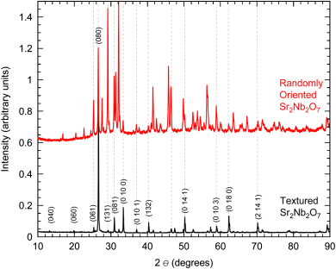
Texture is obvious by eye; Rietveld puts a number on it
Sr2Nb2O7: clearly textured to the b-axis, but what is the preferred orientation factor?

Slide 39
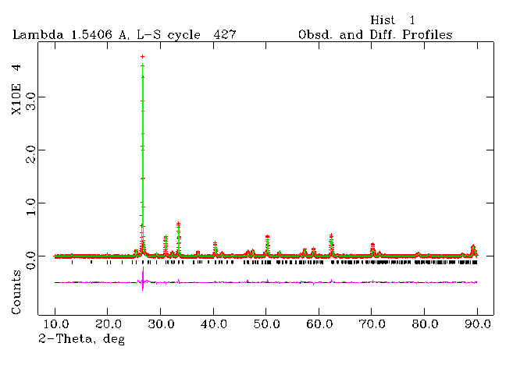
March-Dollase refinement gives Sr2Nb2O7 a texture index of 5.52
Rwp = 6.9%
Texture index = 5.52
Note: the actual compound had a small amount of La3+ doped on the Sr2+ site

Slide 40
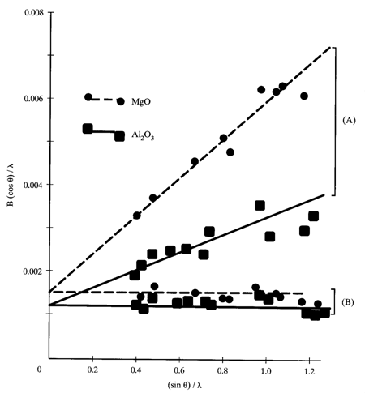
Calibrate the instrument first; leftover broadening is your sample
Characterize instrument shape parameters using a standard
Then U, V, W give the integral breadth for Scherrer and Stokes analysis
  Dv = Kλ / (β cosθ)
  ε = β / (4 tanθ)
  (βobs − βinst) cosθ = λ/Dv + 4ε sinθ
Williamson-Hall: plot βcosθ/λ vs 4sinθ; slope and intercept give strain and size

Slide 41
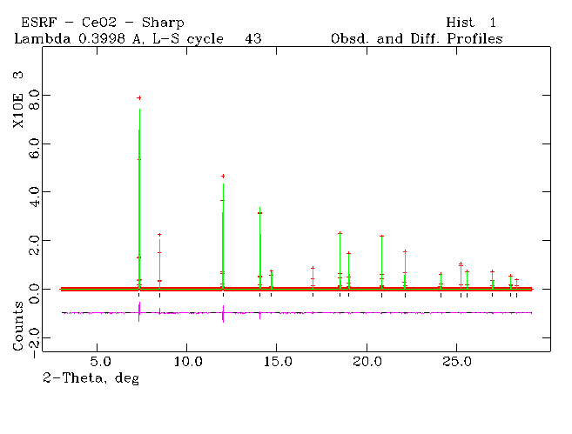
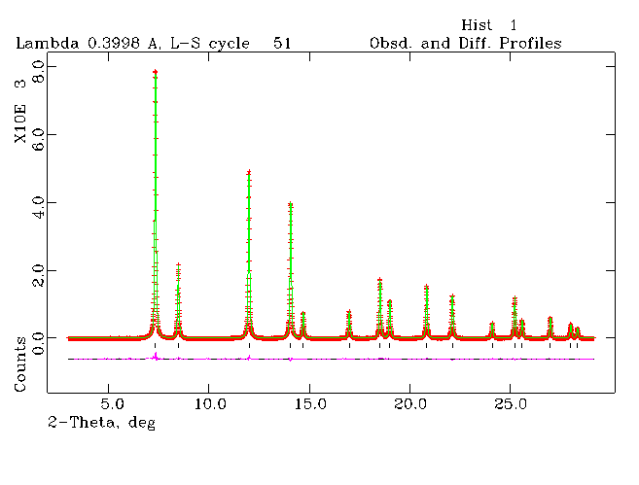
Micronized CeO2 refines to 226 Angstrom domains and 0.011% strain
CeO2 before and after micronizing; volume-weighted domain size Dv = 226 A, maximum strain e = 0.011%

Slide 42
Rietveld refinement is a complete quantitative toolkit
Crystal structure information
  Atomic positions, thermal displacement parameters, occupancy
Beyond the average structure
  Preferred orientation, size, strain, quantitative phase analysis (including amorphous material)
And remember
  Judge fits with the profile plot and chemical sense, not Rwp alone
  Turn parameters on in a correlation-aware order

